Slide 1

CHURN ANALYSIS
GROUP-6
Mentor Name: Miss. Aishwarya
Date: March 2023

Slide 2
Given data
Business Objective:
To predict the Customer churn is a big problem for telecommunications companies. Indeed, their annual churn rates are usually higher than 10%. For that reason, they develop strategies to keep as many clients as possible. This is a classification project since the variable to be predicted is binary (churn or loyal customer). The goal here is to model churn probability, conditioned on the customer features.
Data Set Details:
Each row corresponds to a client of a telecommunications company for whom it has collected information about the type of plan they have contracted, the minutes they have talked, or the charge they pay every month.

Slide 3
Problem statement
1. Can we predict whether a customer will churn or not based on their telecommunications usage patterns and demographic information?
2. What are the factors that contribute the most to customer churn in the telecommunications industry, and how can we use this information to develop targeted retention strategies?
3. How can we optimize our retention strategies to reduce customer churn and increase customer loyalty, based on the customer data we have available?
4. Are there any significant differences in telecommunications usage patterns and customer demographics between customers who churn and those who remain loyal, and how can we leverage this information to improve our customer retention efforts?
5. Can we develop a machine learning model to accurately predict customer churn in real-time, and use this model to proactively intervene with customers who are at high risk of leaving the company?

Slide 4
PROJECT FLOW
Understanding Dataset
Data Visualization
Modelling
Feature Engineering
Re-Build Model
Predictions
Data Processing

Slide 5

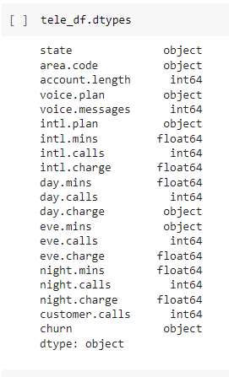
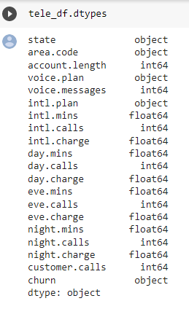
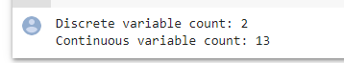
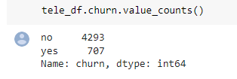
Understanding Data
Changed the data type from object to float for daycharge and evemins.
2 discrete variable count
13 continuous variable count
Churn counts
Yes: 707
No: 4293

Slide 6
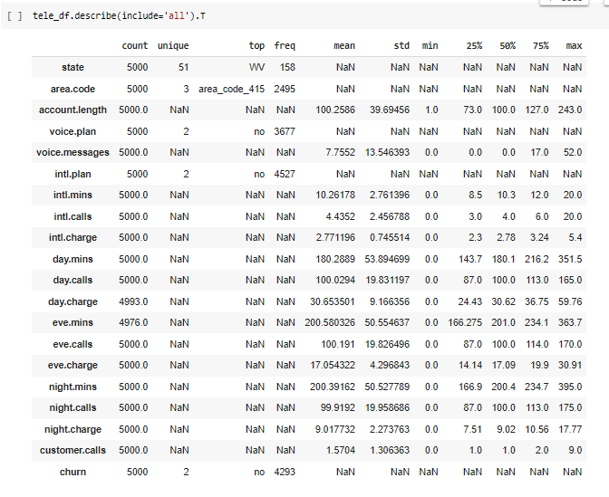
Understanding Data

Slide 7
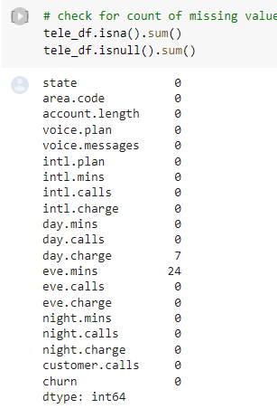
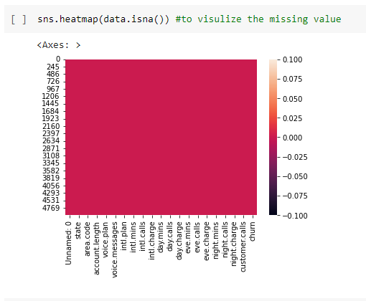
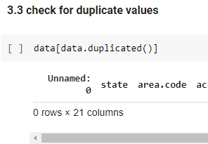
Missing & duplicate values
Heatmap after dropping the missing values.
There are no duplicate values

Slide 8
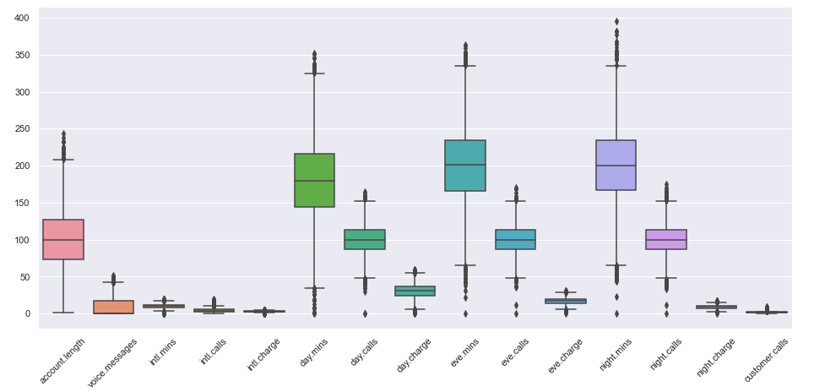
Outlier Values
Outliers were imputed with Median values in each feature.

Slide 9
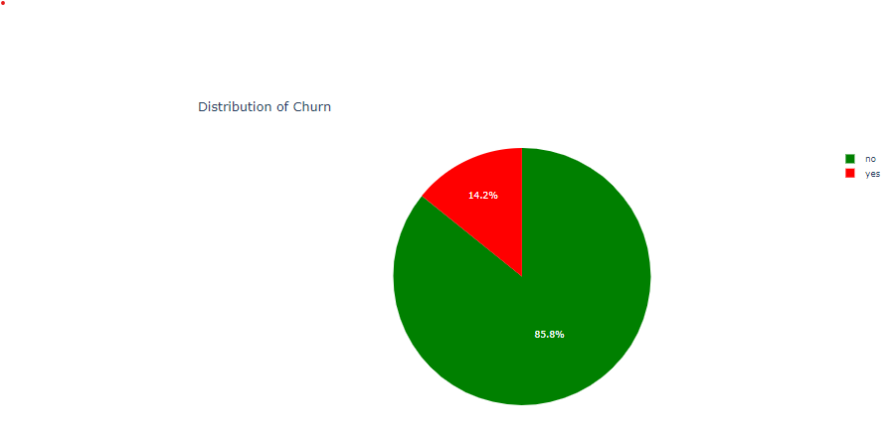
Visualization
Almost 15% customer are churned and remaining are not churned

Slide 10
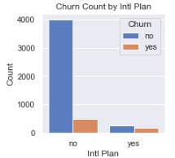
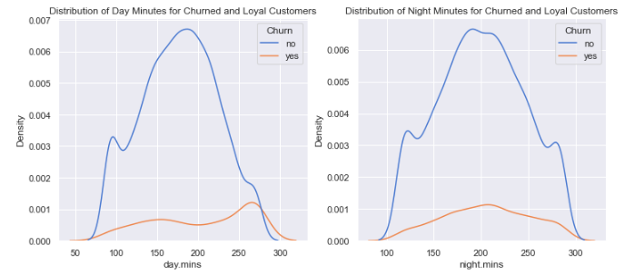
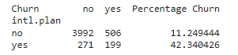
Visualization
Churn count based on intl plan
Distribution of day minutes for churned customers
Distribution of night minutes for churned customers

Slide 11
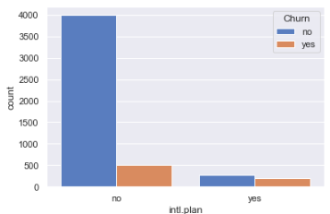
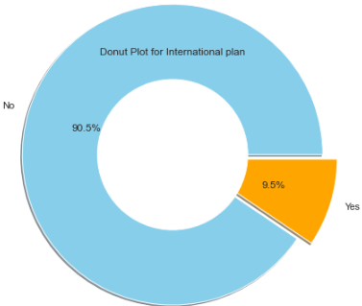
Visualization
Distribution of international customers
There are 3010 customers who don’t have a international plan.
There are 323 customers who have a international plan.
Among those who have a international plan 42.4 % people churn.
Whereas among those who dont have a international plan only 11.4 % people churn.
So basically the people who bought International plans are churning in big numbers.

Slide 12
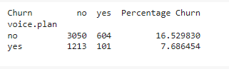
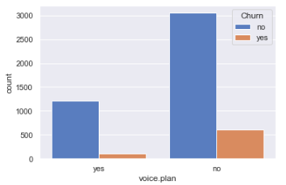
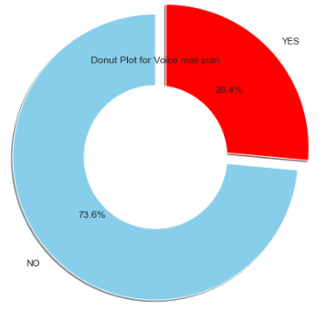
Visualization
Analyzing voice mail column
As we can see there is are no clear relation between voice mail plan and churn so we can't clearly say anything.
This plot shows churn corresponding with the subscription of voicemail plan Out of 922 people having Voicemail plan, 8.7% are Churn.

Slide 13
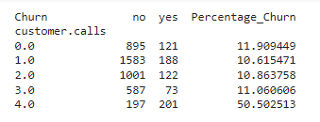
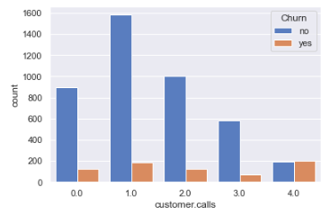
Visualization
Analyzing customer service calls column
From the churn percentage after 4 customer calls 50% of the customer are churning
Customers who have called once also have a high churn rate indicating their issue was not solved in the first attempt.
So operator should work to improve the service call.

Slide 14
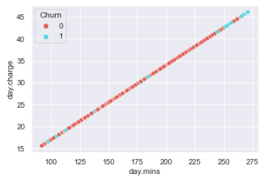
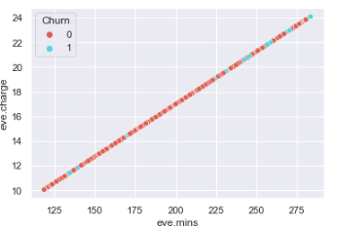
Visualization
Scatter plot to check the linearity between day mins & day charge
Highly corelated
Scatter plot to check the linearity between eve mins & eve charge
Highly corelated

Slide 15
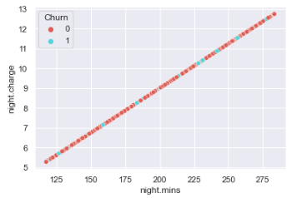
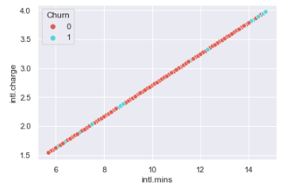
Visualization
Scatter plot to check the linearity between night mins & night charge
Highly corelated
Scatter plot to check the linearity between initial mins & initial charge
Highly corelated

Slide 16
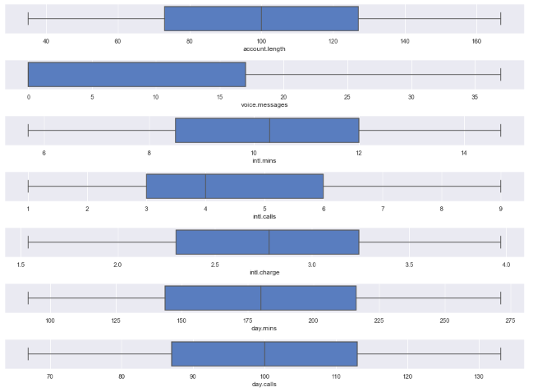
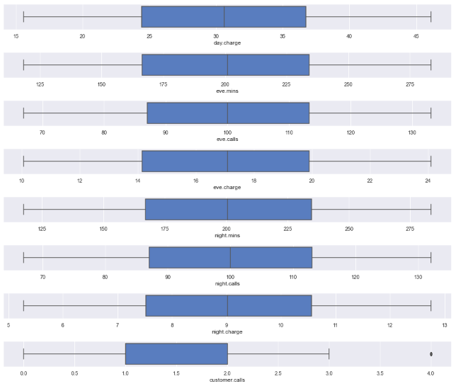
Visualization
Box plot for all the numerical columns in the dataset to check for outlier.

Slide 17
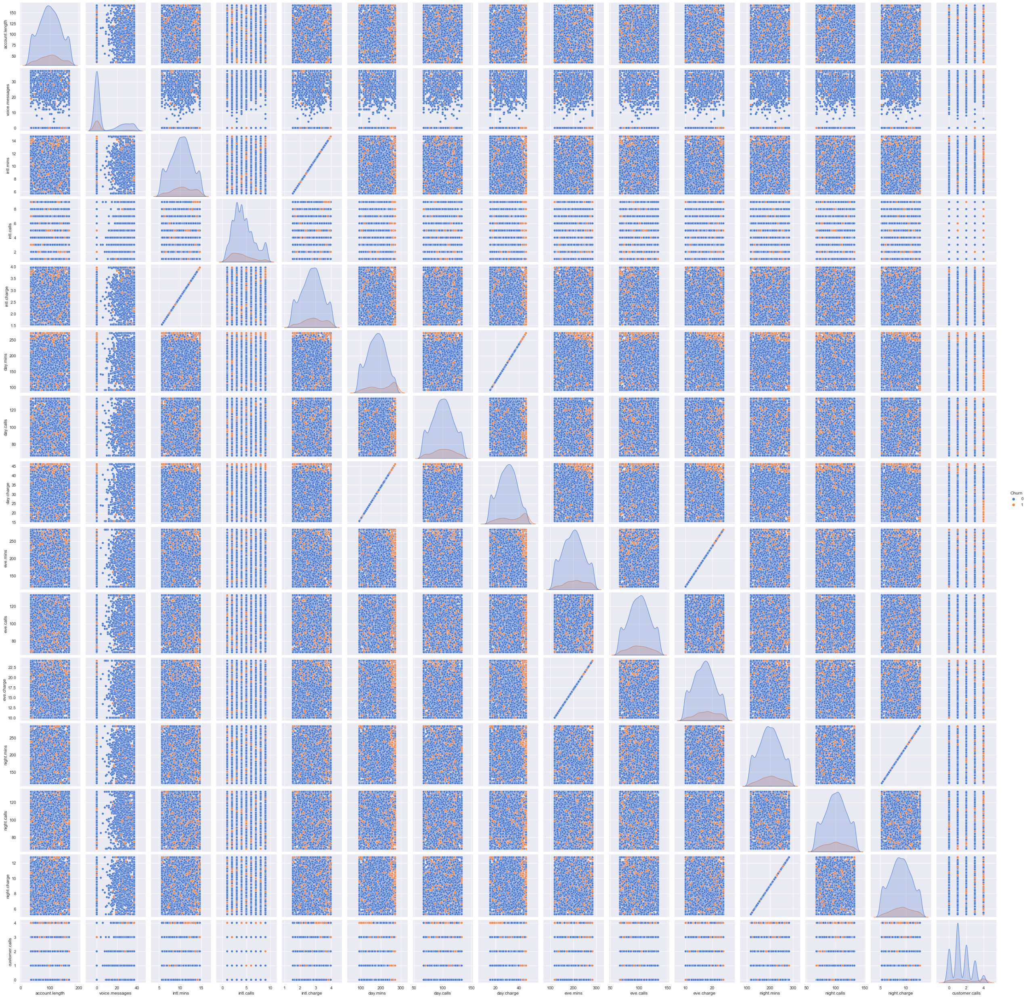
Pair Plot

Slide 18
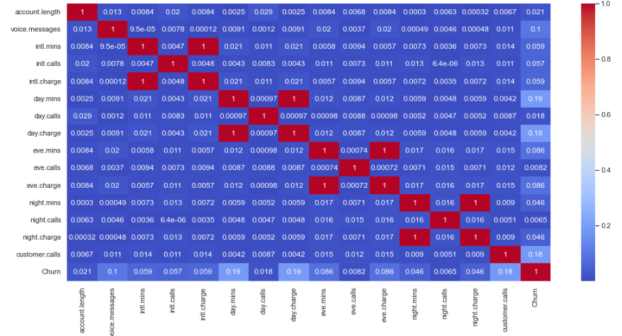
Correlation
Both PairPlot and Correlation chart shows Correlation between : day.charge – day.mins, eve.charge-eve.mins, night.charge-night.mins, intl,charge-intl.mins. But we will also be performing feature engineering and then deciding how to move forward with this information.

Slide 19
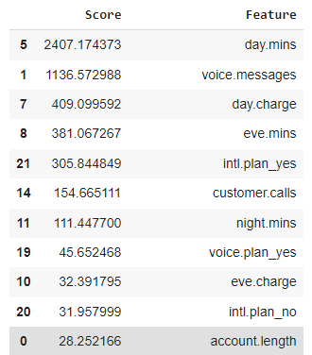
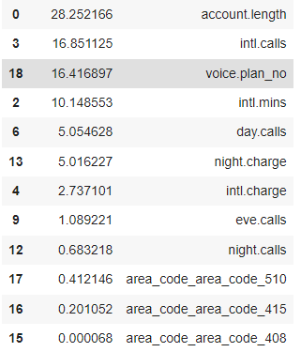
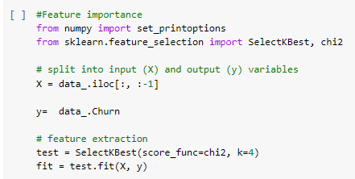
Feature Engineering
Have done k best select to analyze the impact of features on the dataset. And sorted the values. We considered only the first 11 columns until account length

Slide 20
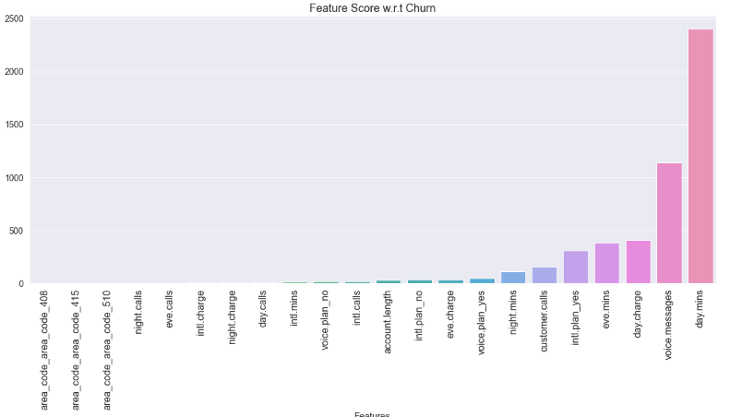
Feature Engineering
Feature score based on churn

Slide 21
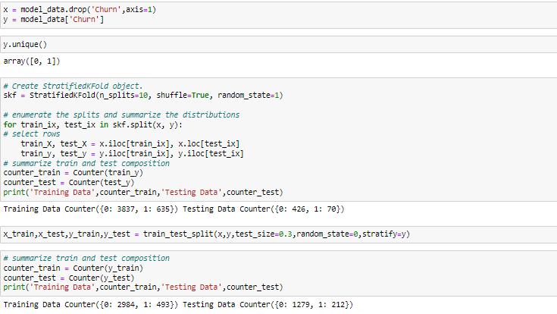
Test Train Split With Imbalanced Dataset For Model Building

Slide 22
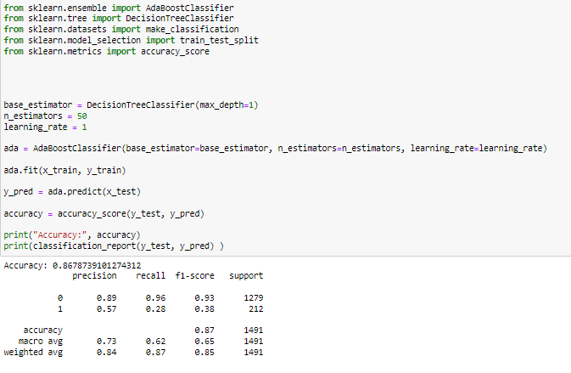
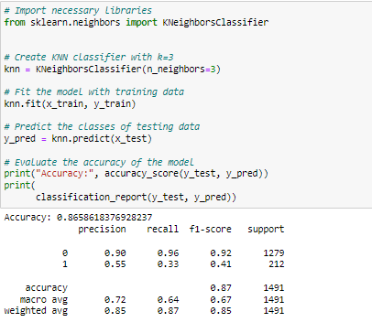
Model building

Slide 23
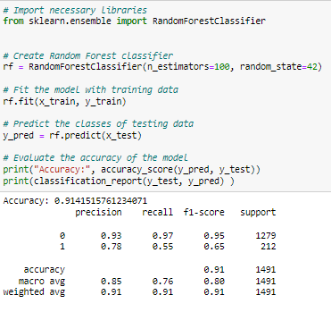
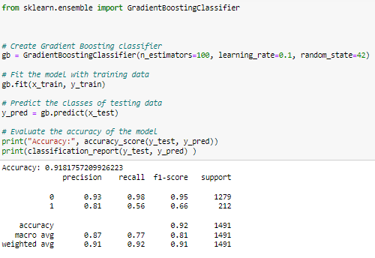
Model building

Slide 24
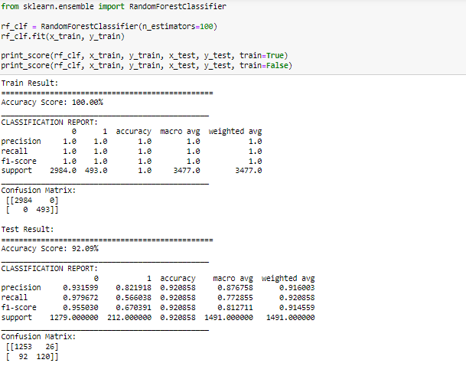
Since the Random Forest Model was Giving Most accurate results, we selected it for the predictive model.
Model Selection

Slide 25
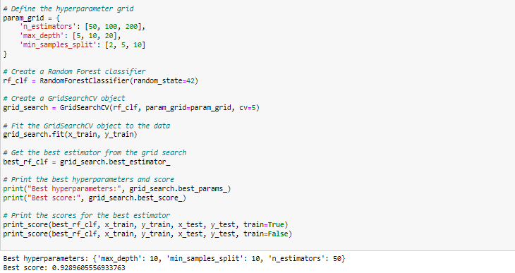
Hyper parameter tuning
Performance Analysis after Resampling

Slide 26
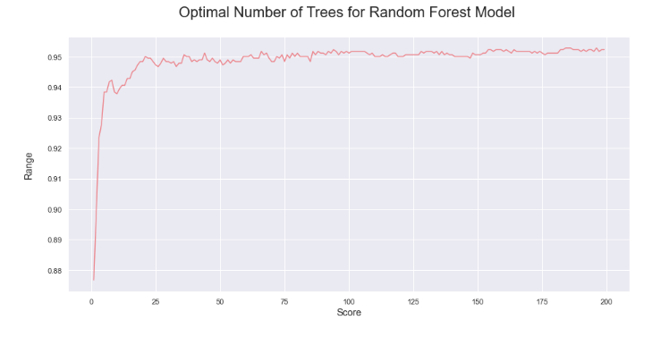
Model Evaluation
Results after Hyperparameter tunning

Slide 27
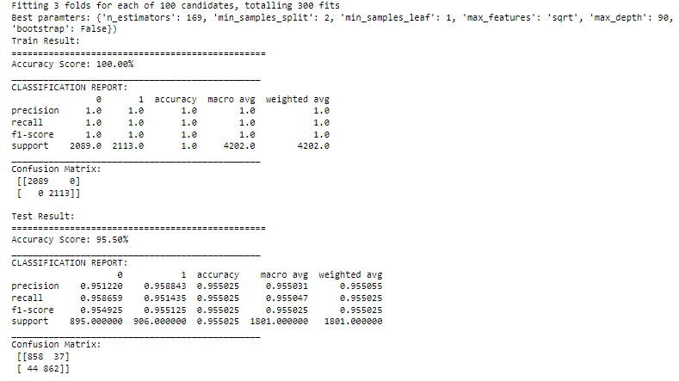
Model Performance

Slide 28
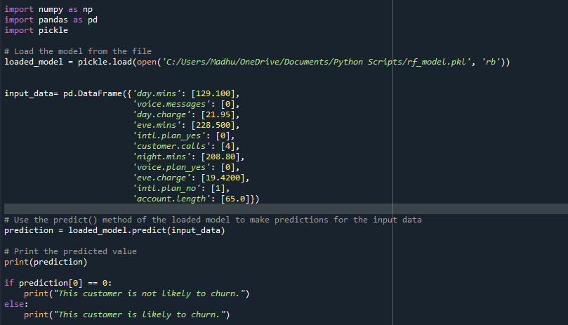
Model Deployment
Predictive Model

Slide 29
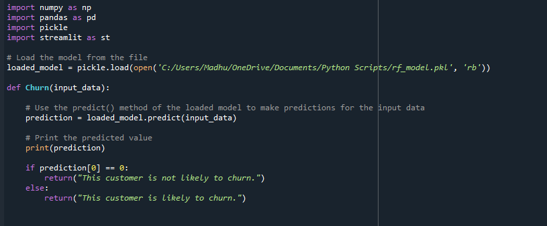
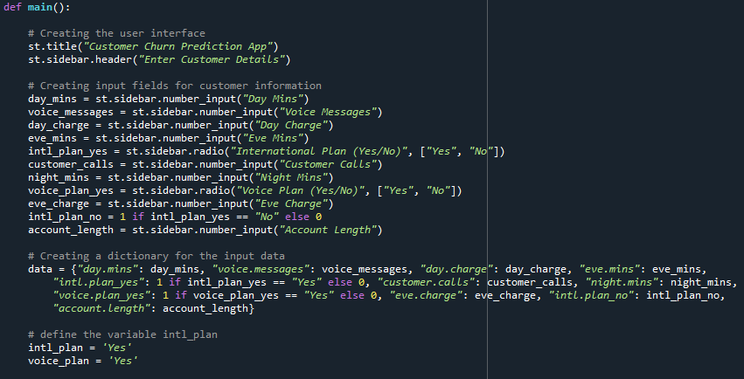
Deployment

Slide 30
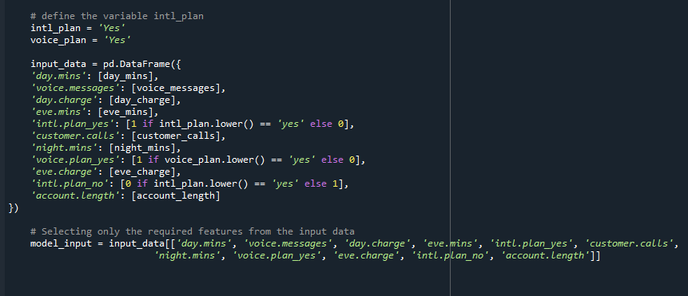
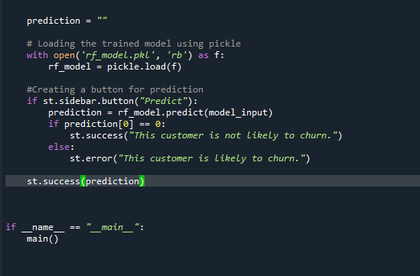
Deployment 2

Slide 31
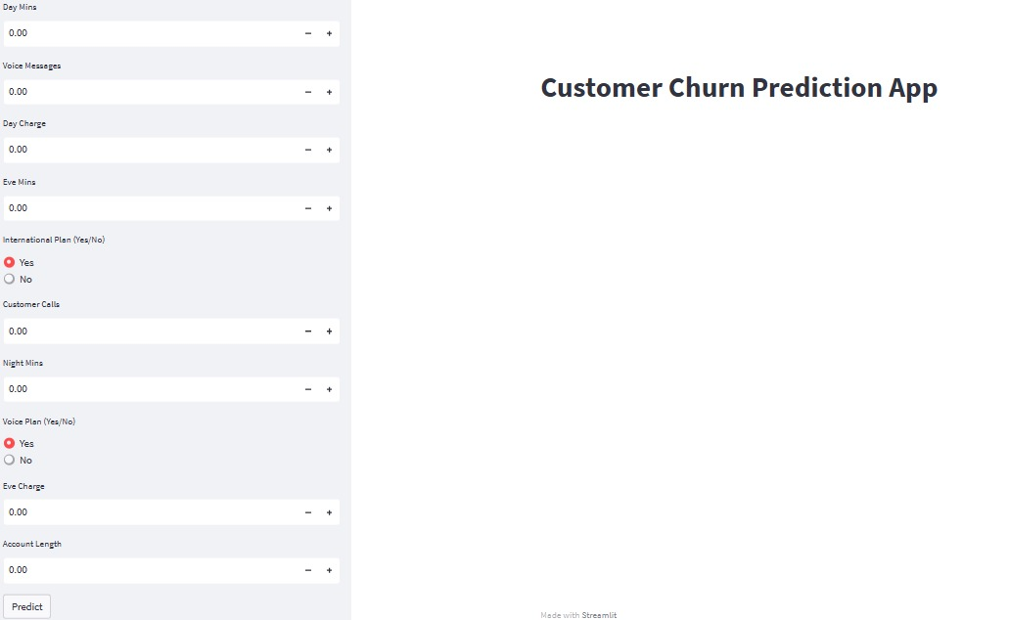
FINAL MODEL
DEPLOYMENT.

Slide 32


